Slide 1
WARNING
20 min
These slides are not optimized for printing or exam preparation. These are for lecture delivery only.
These slides contain a lot of animations. For optimal results, watch in slideshow mode.

Slide 2
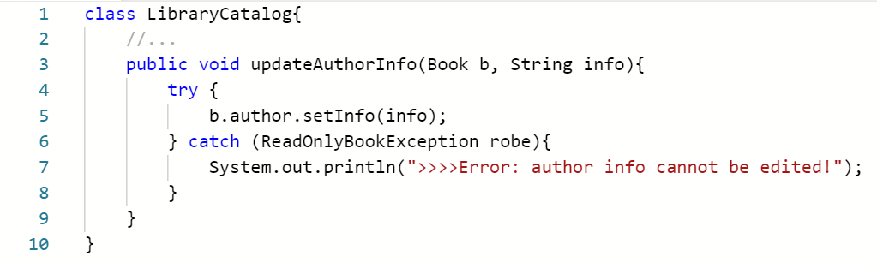
CS2103/T Week 10
Oct 2024
[60 minutes]
Which principles is most clearly violated?
Principle of Separation of Concerns
Single Responsibility Principle
Liskov Substitution Principle
Open Closed Principle
Law of Demeter
Notes:
We start with this question? This is the question.

Slide 3
1
Which principles is most clearly violated?
Principle of Separation of Concerns
Single Responsibility Principle
Liskov Substitution Principle
Open Closed Principle
Law of Demeter
Separate the code into distinct sections, such that each section addresses a separate concern.
Yes
Maybe
No
Yes
Maybe
No
A class should have one, and only one, reason to change.
Yes
Maybe
No
Derived classes must be substitutable for their base classes.
N/A
Yes
Maybe
No
N/A
A module should be open for extension but closed for modification.
Yes
Maybe
No
Don’t talk to strangers
Notes:
Code Overview: The code is a method from the LibraryCatalog class that updates author information, including handling an exception and printing an error message.
Separation of Concerns:
Possible violation as the method is handling both data update logic (line 5) and user interaction (line 7).
Two concerns are mixed: data handling and user communication, leading to a "maybe" assessment.
Single Responsibility Principle (SRP):
Similar to the previous point, there are potentially multiple reasons for this method to change (e.g., data structure changes or UI changes).
Indicates the method may have more than one responsibility, so a "maybe" is also applicable here.
Liskov Substitution Principle:
Not applicable as there is no indication of inheritance or derived classes in the given code.
Open/Closed Principle:
Insufficient information to determine if the code is open for extension but closed for modification.
The method shows no clear sign of extension mechanisms like inheritance or interfaces.
Law of Demeter (LoD):
Clear violation observed in line 5 (b.author.setInfo(info)). The method is accessing methods of another object's field, which violates LoD.
This is marked as the most evident issue in the code.
Conclusion: The answer is the last option Law of Demeter, as it’s the clearest violation, despite suspicions of other principle breaches.

Slide 4
More on LoD violations …
b.getAuthor().setInfo(); // same problem (but slightly better)!
☹ LibraryCatalog has a dependency on the internal object structure of Book! What if we wanted to move the author object to a different location?
i.e., Do not navigate inside the internal object structure!
When paying a delivery person, do we allow that person to reach into your pocket, take your wallet out, and take money from it?
NO !!!
c:LibraryCatalog
b:Book
a:Author
friend of c
friend of a friend of c (i.e., stranger)
Alternatives:
Receive an Author object instead of a Book
Ask the Book to change author info.
Perhaps OK, as the method name clearly states it. But try to minimize.
Don’t talk to strangers
Notes:
Law of Demeter (LoD) Explanation:
The method in LibraryCatalog accesses a property (author) of the Book object it receives, which is considered a "friend of a friend." This violates LoD as the principle dictates that a class should not interact with objects beyond its direct collaborators.
Reason for LoD Violation:
Accessing an internal object structure (e.g., Book accessing Author) introduces tight coupling. This makes the LibraryCatalog class dependent on the structure of the Book class, causing issues if that structure changes later.
Analogy for Better Understanding:
The slide uses the analogy of a delivery person not reaching into your pocket to take money, emphasizing that direct access to another object's internals is unsafe and undesirable – c is delivery person, b is you and a is wallet.
In this contest – we don’t want Library object to have dependency on internal object structure like author.
Implications of Violating LoD:
It increases coupling and dependency, making the system harder to maintain. If the internal structure changes (like moving or renaming variables), the class relying on it (LibraryCatalog) would also need modifications.
Encapsulation is Not Enough:Even if the author variable in the Book class is made private and accessed via a method (e.g., getAuthor()), it still violates LoD. The issue remains because the LibraryCatalog class is still navigating through the object structure, accessing the internal Author object indirectly.
Alternative Solutions: What can we do in this case?
One solution is to pass the Author object directly to LibraryCatalog, making it a direct collaborator and resolving the LoD violation.
Another option is to ask the Book object itself to update its Author information without directly accessing the Author instance.
Trade-offs:
While these alternatives reduce coupling, they come with their own costs, such as potentially increasing code complexity. The current approach might still be acceptable if it's clearer and simpler.
Takeaway:
Although LoD violations are common, it’s crucial to minimize them when possible. Evaluate the trade-offs of each solution and aim to balance simplicity and adherence to principles. Based on the cost involved you can try to minimize it or not.

Slide 5
Which statements about this CCD are correct?
2
read by
CCD is a model of the real world. The design and the implementation of the solution can be guided by it, but it’s not the same.
→ avoid implementation-specific terminology when discussing the problem domain.
Course
10..*
Student
code
name
1
coordinator
Instructor
*
instructors
A. The instructors variable in the Course class can be of type ArrayList<Instructor>
B. The Course class can have methods to add students to a specific course.
C. There are alternative designs that can be more efficient to implement.
D. Although not shown in the diagram, it is likely the Student class has attributes such as name, student number, gender etc.
E. Instructor objects can play the role of coordinator.
Notes:
Emphasize Domain Modeling:
The CCD (Conceptual Class Diagram) models the real world, and its purpose is to represent the domain clearly without bringing in implementation details.
Eliminate Solution-Specific Terminology:
Terms like variable, ArrayList, methods, design efficiency, and implementation are solution domain concepts and should not appear in a CCD. Statements A, B, and C are therefore incorrect as they introduce these terms.
Distinguish Between Domain and Solution Terms:
Attributes, roles, classes, and objects can exist in both the domain and solution domains. In CCDs, they are acceptable as they align with real-world concepts.
Correct Statements:
Statements D and E are valid as they discuss attributes of the Student class (likely found in the real world) and the Instructor playing a role (which aligns with real-world modeling).
Final Answer:
The correct answers are D and E. These statements align with domain modeling principles and avoid implementation-specific terminology.

Slide 6
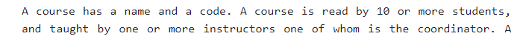
read by
Multiple acceptable ways to model a domain!
Course
10..*
Student
code
name
Course
teaches
coordinator
code
name
Person
1
1..*
Instructor
Simpler
*
instructors
Role
More flexible
isCoordinator: boolean
read by
c1:Course
c2:Course
c3:Course
Course
10..*
Student
code
name
:CoordinatorRole
Person
:CoordinatorRole
*
1
Tom:Person
InstructorRole
CoordinatorRole
:InstructorRole
*
isPastCoord: boolean
:CoordinatorRole
Jane:Person
Notes:
Multiple Ways to Model a Domain:
Domain modeling allows for various acceptable solutions, unlike class diagrams for code where there are fewer alternatives. We saw this solution in tutorial after ruling out 2 variations. This is simpler solution.
Example Domain Model Options:
Another Option: Introduces a Person class and separates roles (InstructorRole, CoordinatorRole). This model is more flexible and can capture additional information like past coordination roles.
Verifying Models:
You can validate models using object diagrams. The concrete scenario presented aligns with the model, confirming it works as intended.
Trade-offs in Model Selection:
Simpler models are easier to implement and understand but may not handle all scenarios.
More complex models are flexible and can accommodate changes, like storing additional information, but may be harder to maintain.
Role of the Association Class:
Another alternative uses an association class (Role) between Person and Course, adding flexibility in representing relationships but possibly introducing limitations in capturing all required details.
Key Takeaway:
There isn’t always a single correct way to model a domain. Select the model based on the trade-offs, simplicity, and flexibility required for the given scenario.

Slide 7
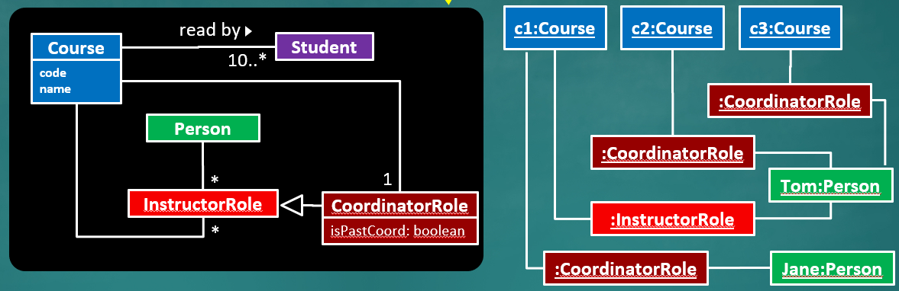
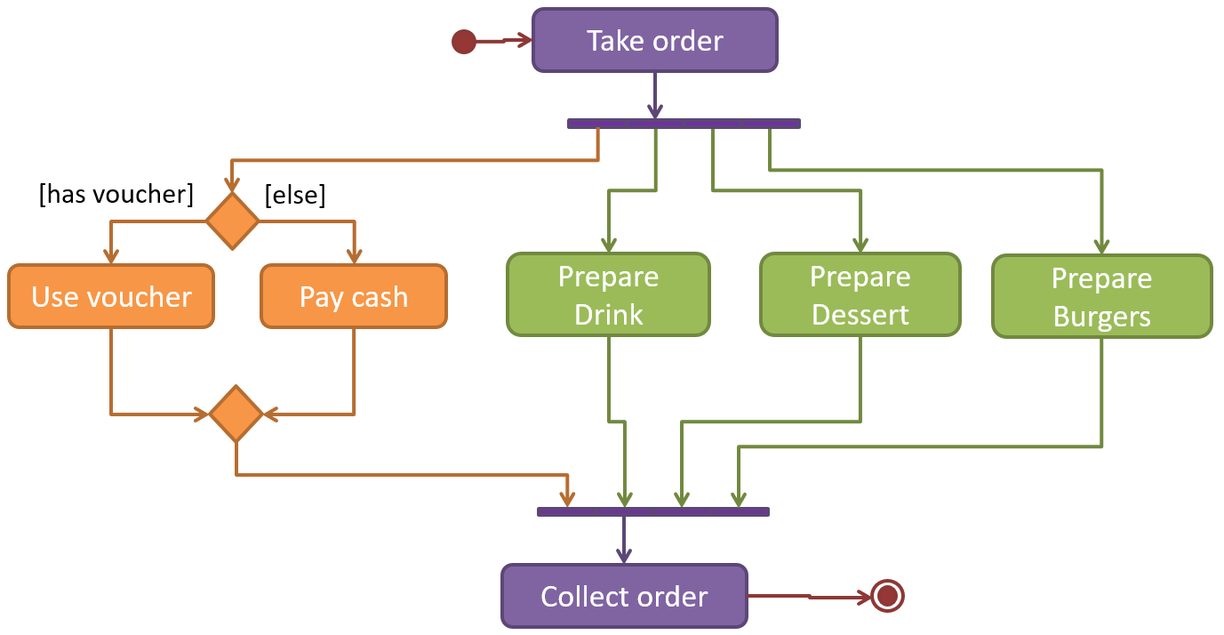
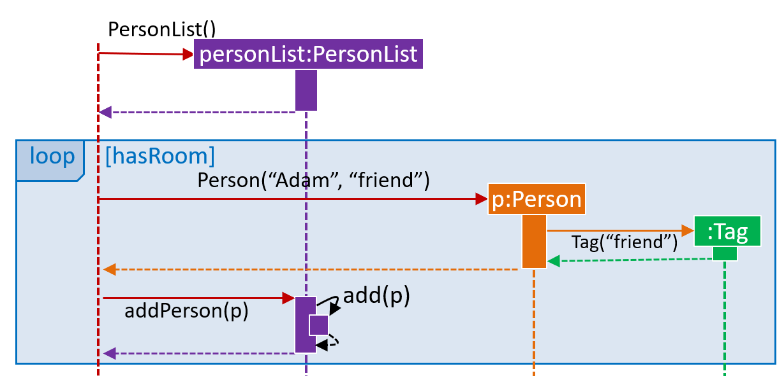
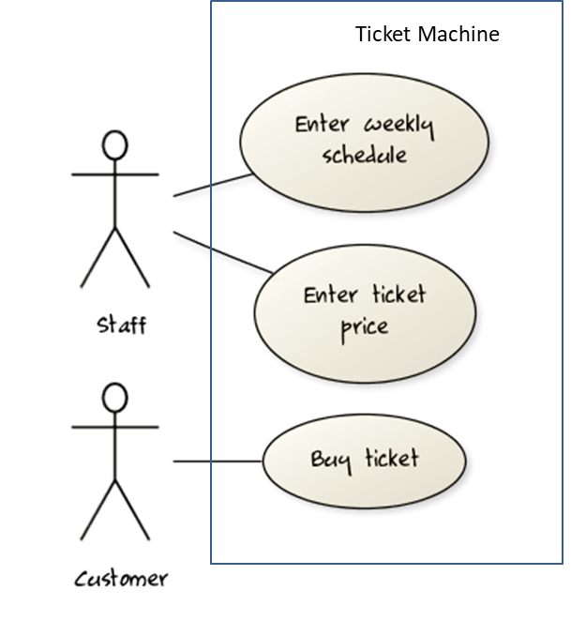
Which can be used for domain modelling?
3
A CCD
An object diagram
An activity diagram
A sequence diagram
A class diagram
A use case diagram
Anything (not just UML diagrams) that can represent the problem domain can be used for domain modelling.
Notes:
Which of these can be used for domain modeling when we're modeling the real problem, not the solution.
Domain Modeling Techniques:
Several diagram types can be used for modeling the problem domain, not just the solution domain.
Applicable Diagrams:
Activity Diagrams: Useful for representing real-world processes (e.g., actions in a shop). They can also depict algorithms in the solution domain.
Sequence Diagrams: While typically used for the solution domain (e.g., method calls), they can be adapted to show interactions between entities in the problem domain – it is possibility.
Use Case Diagrams: Generally illustrate how users interact with a system (solution domain), but can also model non-software systems by depicting different entities and their interactions.
Not Applicable:
Class Diagrams: No - Specifically for modeling the solution domain. Instead, we use conceptual class diagrams (CCDs) when modeling the problem domain.
General Principle:
If UML diagrams are not suitable, other forms like formulas, graphs, or charts are acceptable as long as they reasonably represent the problem. However, using standard UML diagrams is preferred for consistency and clarity.
Answer: Except Class diagram, ALL are possible.

Slide 8
Which SDLC process model is used by Google?
4
Scrum
XP
Unified process
None of the above
Some companies ‘claim’ to follow a specific process.
Many companies do use specific parts e.g., daily scrum.
Most companies have their own process(es) that may borrow from these process models.
Notes:
Companies' Process Claims:
Many companies claim to follow a specific software development lifecycle (SDLC) process (e.g., Scrum) for credibility, especially in bids for projects.
Partial Adoption:
Often, companies use only parts of a process, such as daily Scrum meetings, but may not fully adhere to the entire methodology.
Customized Processes:
Most companies develop their own versions of these processes, customizing them to fit their needs rather than following a standard process strictly.
Google's Approach:
Google does not adhere to a single SDLC process. The company is too large and diverse to enforce a rigid, uniform method across all projects.
Each project team may use its own approach, adapting and evolving it based on what works best for that specific context.
Correct Answer:
The answer to the question is "None of the above" since Google customizes its processes, and no single standard process model applies company-wide.

Slide 9
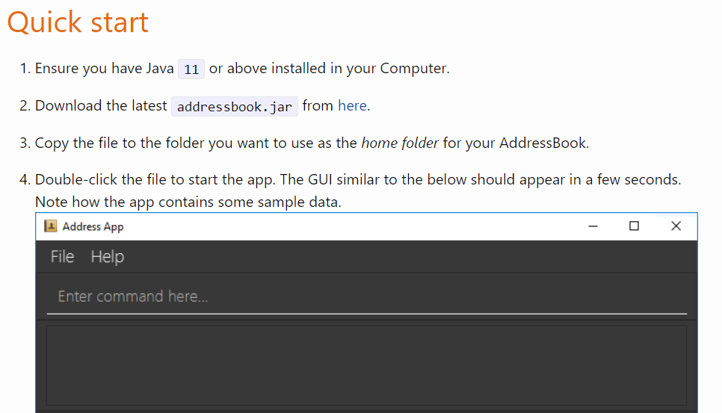
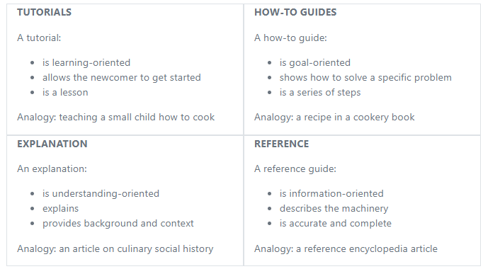
The ‘Quick start’ section of your tP UG belongs to which category?
5
Try to keep each doc within one category, although minor cross-overs may be unavoidable.
Notes:
Identifying Documentation Type:
Software documentation can generally be categorized into four types: tutorials, how-to guides, explanations, and references.
Quick Start Guide Classification:
The Quick Start guide primarily fits into the "Tutorial" category as it is learning-oriented, aimed at helping newcomers get started.
Comparison with Other Types:
While it has elements of a how-to guide (goal-oriented steps), its primary focus is to guide a newcomer, which aligns more with a tutorial.
Overlap Between Types:
Documentation may sometimes blend elements from different categories, but it is crucial to maintain the primary focus of the guide.
Purpose and Structure:
Tutorials aim to provide a learning experience for new users, introducing them gradually through basic steps and explanations.
Avoiding Category Crossover:
When writing documentation, it’s important to keep each document within its intended category to avoid confusing the reader with mixed content.
Ensuring Clarity:
Each type of document has a distinct purpose (e.g., Quick Start for beginners, FAQs for common issues). Avoid mixing these to maintain clarity and effectiveness.
Answer is Tutorials.

Slide 10
v1.2
How?
Notes:
Around this time you must have finished, or you are supposed to finish this first major iteration.
Yeah, you change the product. You have your own product at this point.
So how did it go?
That's what we are wondering ☺

Slide 11
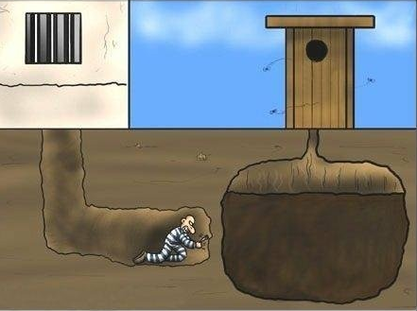
v1.2
How?
Notes:
Perhaps everything went well until the very last moment, and then things got really messy messy ☺

Slide 12

Notes:
or perhaps you try to do too many things at the same time. Big Bang. and then what you get is a big bang.

Slide 13

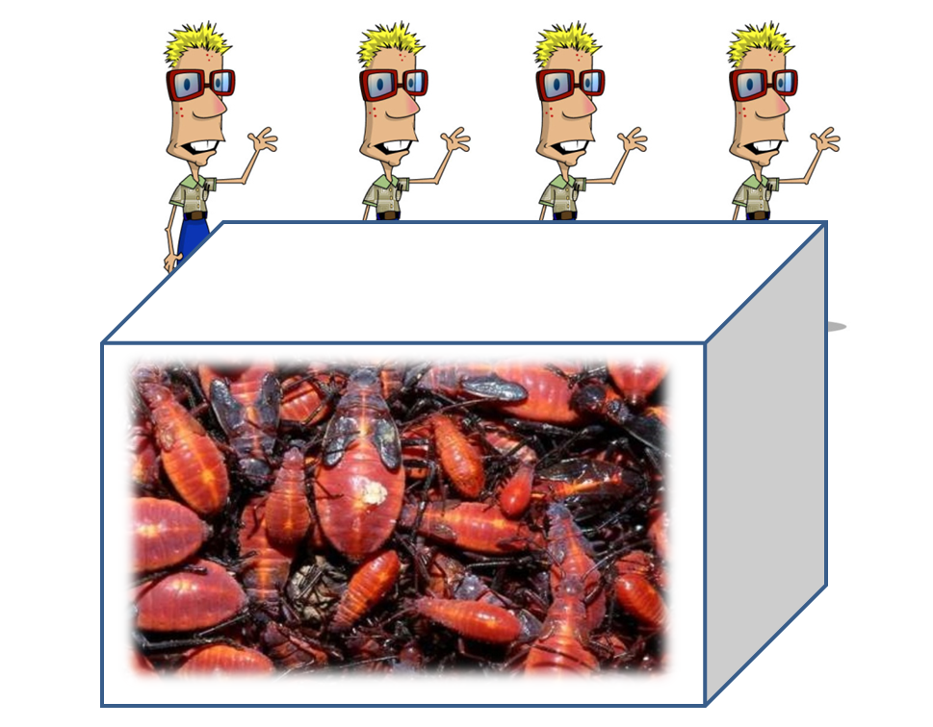
Notes:
Too many bugs. If not, maybe you're not aware of the bugs in the code yet.

Slide 14


Notes:
Did you end up cutting more than your fair share of the load - that happens a lot?

Slide 15
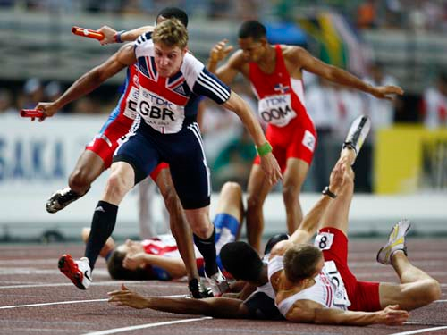
Notes:
Handovers don't go smoothly all the time.

Slide 16
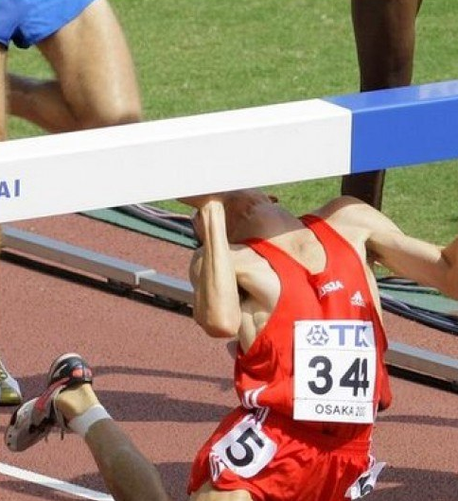
Notes:
Quite a few teams overshot the deadline - despite we telling to split it take small features, etc. Quite a few teams couldn't finish on time.

Slide 17
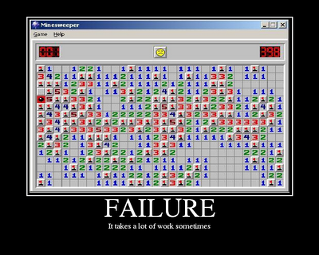
Notes:
And sometimes it's just plain bad luck, you know, even looking back, you can't think of a better way to make that decision. You made a decision turned out wrong, or it's it was entirely out of your control. That happens. Should be able to recover with strength.

Slide 18
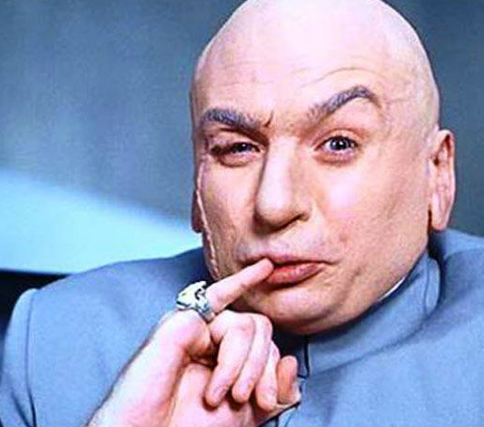
Notes:
if these things didn't happen to you? That's too bad.
Because we wish that these things will happen to you, we hope. Why?
Because these are great learning opportunities, because eventually this will happen - so it's better to happen here in this safe environment, where you can recover, learn from them and the cost is very much less compared to an internship or a job or a real project. The stakes are higher.
so hopefully, these or some of these things will happen to you
and if they did happen to you – that’s great right? at least that's the way to look at it.

Slide 19
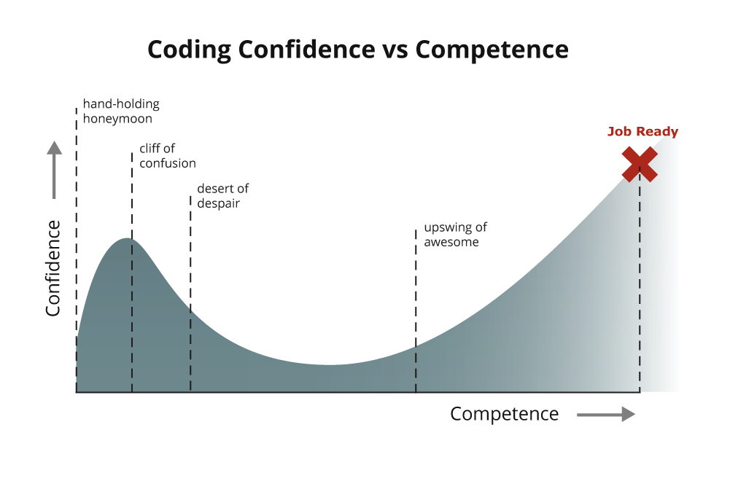
Early programming modules
CS2103/T
http://www.vikingcodeschool.com/posts/why-learning-to-code-is-so-damn-hard
Notes:
This graph illustrates a common phenomenon in programming courses.
In the early modules, we provide a lot of scaffolding and hand-holding to help build your confidence and get you motivated, even if you don’t have a background in coding. We want you to feel comfortable and interested, so we guide you up to this initial peak of confidence.
However, to prepare you for the messy realities of real-world projects and challenges, the next step is to move beyond this initial boost. You have to go through the “valley” — a period where things might slow down, your confidence might take a hit, and you may start questioning your interest in programming. You might feel like, “I used to love coding, but now I’m not so sure.” This where this course is.
The sooner you encounter and work through these difficulties, the sooner you can begin the climb back up. This phase is critical because it’s where real growth happens. As you work through challenges, you’ll eventually reach a point where your confidence and competence align. Unlike the initial phase, where confidence might be inflated, this time, your confidence will be backed by actual skill.
This graph isn't just something I've observed in my own classes. I used to have my own diagram to explain this, but then I found this graph and realized it's a universal experience. Everyone who learns to code goes through this.
So, while it might be uncomfortable, it's essential. You may not reach the peak of competence in this course alone—it's too short—but by the time you graduate, you’ll be much closer to that point.

Slide 20

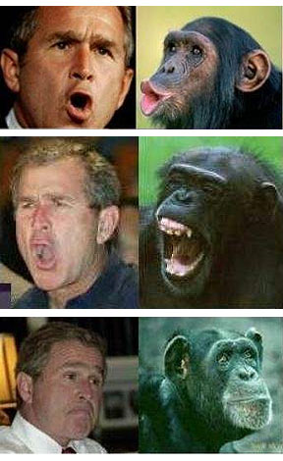


[Extra] what you think you can do
What you can do
What you think you can do

Slide 21

v1.3
Notes:
Now, talking about the projects right now - the product that you have probably small, still small, rough and sometimes not even pretty - quite ugly at this point.

Slide 22

v1.6
Notes:
but at the end of 1.6 - This is what we want.
Stay small but polished, valuable, gem of a product.

Slide 23
v1.3
v1.6
Notes:
and to get there. We have 3 more iterations.

Slide 24
v1.3
v1.6
v1.4
v1.5
v1.6
Not like this!
Notes:
The workload itself is supposed to be flat ideally.
might be a little bit like this, and you know, depending on midterms, etc.
Should not be like this. And nowadays it's rarely like this because we have the feature freeze.
Because of that, this kind of spike in workload in the in the last iteration that doesn't happen.

Slide 25

v1.2
v1.6
Notes:
Talking about polishing gems – look at this video
This video shows very old school technique of polishing gems - Observe what the guy is doing.
Polish a little, then check.
Again polish a little bit more. check again.
Then check again.
And now he's not polishing the gem, but he's polishing something else. That’s the wheel itself, right?

Slide 26


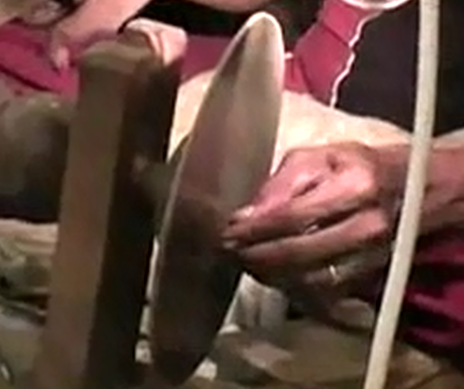
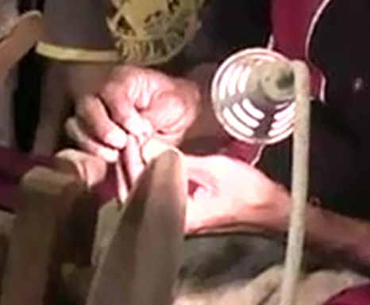
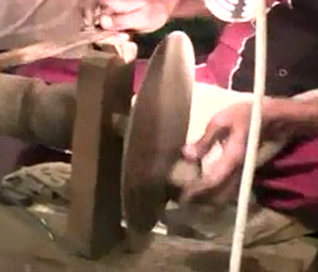
1. Aim to create a gem you will be proud to wear
2. Polish, check, polish, check, polish, check,…
3. Sharpen your tools once in a while
Notes:
You aim for
Small steps - iterative steps like change code in small steps, do tests, check it, etc.
Don’t focus too much on codes – instead focus on sharpening your skills, process, etc. Spend some time to learn the tools/sharpen the skill in Git, etc. Focus on these things as well.

Slide 27
Notes:
Once you are done with 1.2, we want you to do the following:
Do a postmortem of the previous iteration – think how it went well, what didn’t go well, how to improve process, etc. How can you speed up PR merging, come up with own policies, get team consensus to make things better in next few weeks.

Slide 28
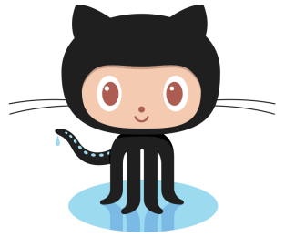
PR, review, merge
Team repo (remote)
Forked repo on GitHub
GitHub
Remember to ‘protect’ the master branch
push
pull
branch
The feature branch workflow
Local repo
You
Recommendation: switch only when you are already comfortable with the forking workflow
Notes:
Sometimes, you can adjust the process rigor – like this:
Earlier, you were asked to follow the forking workflow, where everything goes through your fork. You push changes there and create a pull request (PR) from the fork. Alternatively, you can use the feature branch workflow, which bypasses the fork. In this method, you push the branch directly to the team repository, create the PR there, review it, and then merge it before pulling the changes back. This approach has fewer steps.
However, if you use the feature branch workflow, it means everyone has push permissions to the team repository. This increases the risk, such as accidentally deleting the master branch. Therefore, it’s crucial to protect the master branch when using this workflow.
When should you switch to this approach? It’s not mandatory; it’s an option. In fact, trying it out at some point can be beneficial, as it allows you to know both workflows, which is valuable.
Our recommendation might seem counterintuitive. If you find the current workflow slow or cumbersome, you might feel tempted to switch. However, if that’s the case, it indicates you’re not yet comfortable with the forking workflow. It’s better to master the current process before switching to the feature branch workflow. Mastering one workflow well is more important than trying to learn both simultaneously without adequate practice.

Slide 29
read by
Choose the CCD that matches this description best.
Each student chooses up to 3 focus areas, one of which can be selected as the primary focus area.
Course
code
name
1
coordinator
Instructor
*
instructors
(a)
(b)
Student
Student
Area
0..1
primary
isPrimary: boolean
Area
Note how the experience from the tutorial helped you ‘pattern match’ a solution here.
0..3
focus-areas
0..3
focus-areas
(c)
Student
1
primary
Area
PrimaryArea
0..2
focus-areas
Notes:
Anyone feeling like Deja Wu?
The problem description is similar to the tutorial exercise, where a course can be taught by multiple instructors, and one must be the coordinator. Here, it’s about focus areas for students, with one being primary area.
These models presented here mirror the ones from the 3 models in tutorial - showing three different models—only one of which we worked previously.
Model B aligns with the successful model from the tutorial, and it’s the correct choice here as well.
Models A and C fail for the same reasons they did in the tutorial.
The key takeaway is that encountering similar scenarios helps build pattern recognition skills, allowing quicker identification of correct models that can work and that doesn’t work. If you remember that pattern in the tutorial, then you can immediately go to this answer (B) quickly and discarded (A) and (B) faster.
As you encounter more of these problems, you’ll become faster at recognizing which models work based on previous experiences – need pattern matching skills.

Slide 30
Design patterns: Singleton, Façade, Model-View-Controller etc.
Design principles: SOLID, LoD, SoC, etc.
Fundamental design concepts: Abstraction, Coupling, Cohesion
Notes:
Few weeks ago we learned these fundamental design concepts – use right abstraction, lower coupling, increase cohesion.
How to do these? We learned that can be done by learning Design Principles. They give us more guidance. But they are very high-level or only gives the direction. But not more details. It will be nicer if they say the details like: do this exactly, these are the classes you need to use, this is the association, this is the inheritance you should use, etc.
For this case, these principles don't do much help – But something that does do it is this thing called design patterns. This week we will start learning about this concepts and few examples on DP.

Slide 32

ARIANE 5 launch
Notes:
I suppose many of you have seen this before, so you might know the story this long ago.
This is another infamous, Failure story. It blew up soon after launch, destroyed like millions of dollars worth of stuff.
But luckily no lives were lost because it was unmanned.
So what happened?

Slide 33

Here’s an error message
System 1: issue navigation commands
Navigation instructions?
System 2: control the path of the shuttle
Uh oh. Off-course. Kaboom!
System 3: monitor the flight path
Notes:
The scenario involves three key subsystems that work together, each with its specific responsibility.
System 1 detects an anomaly and sends out an error message—nothing unusual at first glance.
System 2, which reads navigation instructions, was not designed to handle error messages, so it mistakenly interprets the error message as a navigation command.
As a result, the shuttle goes off course because the interpreted command doesn't make sense in a navigation context.
System 3, responsible for monitoring the flight path, detects the off-course situation and triggers the self-destruct mechanism to avoid further catastrophe.
The point highlights the importance of properly handling different message types in code, as misinterpretations can lead to critical failures, just like in this example.

Slide 34
Here’s an error message
Navigation instructions?
Your code
Your teammate’s code
Notes:
These kind of things can happen in your project as well.
When coding, you and your team members may have different assumptions about return values, such as using null, an empty string, or an error code for a specific condition. If these assumptions are not aligned, each member may code independently with incorrect expectations, leading to issues when integrating their work.
This misalignment can cause major bugs or even system failures when components interact.

Slide 35
Your code
Putting up defences to protect our code.
Your teammate’s code
Notes:
To prevent such issues, it's crucial to build defensive coding practices, ensuring your code can handle unexpected or incorrect inputs from others.
By safeguarding your code against potential errors from other parts, you minimize the risk of cascading problems and maintain system stability.

Slide 36
Your code
Putting up defences to protect our code.
Your teammate’s code

Slide 37
Lecture 7:
Putting up defences to protect our code.
Notes:
In this course, we cover four ways to handle issues that arise from wrong assumptions or unexpected conditions in programming.

Slide 38
MISUNDERSTANDINGS
GO!
Notes:
The first category is Misunderstandings, where you make incorrect assumptions and act based on them. To address this, we use Assertions—a way to specify an expectation and alert when it's not met.

Slide 39
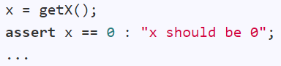
MISUNDERSTANDINGS
GO!
Assertions
Notes:
Assertions help set assumptions explicitly and act as an alarm system to notify you immediately if the assumption fails.

Slide 40
MISUNDERSTANDINGS
MISHAPS
GO!
GO!
Assertions
Notes:
The second category is Mishaps—situations where things go wrong despite precautions, like missing files or incorrect user inputs. Here, we use Exceptions to detect, handle, and recover from these issues.

Slide 41
MISUNDERSTANDINGS
MISHAPS
GO!
GO!
Assertions
Exceptions
Notes:
Assertions are proactive for assumptions, while exceptions are reactive for unexpected problems. Both are essential tools in ensuring code robustness.

Slide 42
Assertion or exception?
A developer screwed up e.g., a method is given null as a parameter although null values are not supposed to reach that method
→ Use assertions to abort
A user screwed up (or a problem in the environment) e.g., A file is not found in the expected location
→ Use exceptions to handle
Notes:
There are two scenarios – one of them need assertion, while other needs exception. Which one is which?
First - Assertion
Second – Exception
Assertions are used when the developer has made a mistake or the code has a bug. They help catch these errors immediately, stopping the execution to indicate that something is fundamentally wrong and needs fixing.
Exceptions, on the other hand, are used when something goes wrong due to external factors (like user input errors or missing files). They allow the program to detect the issue, handle it gracefully, and continue running.
In short, Assertions stop the program when there’s a code bug, while Exceptions help the program recover and keep going when unexpected events occur.

Slide 43
Assertion or exception?
A developer screwed up → Use assertions to abort
A user screwed up → Use exceptions to handle
Consider this method:
execute(String userCommand)
If the userCommand is in an incorrect format, it should be handled using,
Assertions
Exceptions
It depends
Notes:
This is like your tP – user command is incorrect format – so user screwed up – so exception?
But the answer is it depends.
When handling an incorrect format in a method, the choice between assertions and exceptions depends on the context.
If there’s another method that should have validated or corrected the input before it reaches this point, and the incorrect format still occurs, then it indicates a developer error (a bug). In this case, use assertions.
If this method directly handles user input without any prior validation, then it’s likely a user mistake. Here, use exceptions to handle the error gracefully and avoid crashing the program.

Slide 44
Assume your app tries to contact a Google API. If the Google servers are down, it should be handled using,
Assertions
Exceptions
It depends
Notes:
Based on the previous logic, here once again “it depends” – for this question as well.
But, even if you check the server status beforehand, there’s no guarantee it will remain up by the time your app accesses it. Servers can go down unexpectedly.
Since you cannot assume that the server will always be available, relying on assertions or checks prior to the API call is insufficient.
Exceptions are designed to handle situations like these where external dependencies (e.g., remote servers) might fail or become unavailable.
So although in the slide I have marked the last option as the correct answer, I'm telling you - The correct answer on the slide should be marked as "Exceptions" instead of the default "It depends," based on this explanation.

Slide 45
MISUNDERSTANDINGS
MISHAPS
MYSTERIES
GO!
GO!
GO!
Assertions
Exceptions
Notes:
Sometimes, something goes wrong in your code, and you can't reproduce the issue or figure out why it happened. In these cases, it would be helpful to have a 'CCTV' that recorded everything so you can review what exactly went wrong.

Slide 46
MISUNDERSTANDINGS
MISHAPS
MYSTERIES
GO!
GO!
GO!
Assertions
Exceptions
Logging
Notes:
That’s where logging comes in—it captures events so you can trace back and identify the issue.

Slide 47
MISUNDERSTANDINGS
MISHAPS
MYSTERIES
MISUSE
GO!
GO!
GO!
GO!
Assertions
Exceptions
Logging
Notes:
Now, onto the fourth aspect: misuse.
Other developers or users can unintentionally or intentionally misuse your code, leading to unexpected behavior. To prevent this, you need to build in mechanisms that safeguard your code. This is known as defensive programming.

Slide 48
MISUNDERSTANDINGS
MISHAPS
MYSTERIES
MISUSE
GO!
GO!
GO!
GO!
Assertions
Exceptions
Logging
Defensive
Other three plus more!
Use all four in your own tP code!
Notes:
It’s not a separate technique but an approach that integrates various methods, like assertions and exceptions, to proactively protect your code from abuse.
We expect you to apply all these practices in your team project (tP). We'll be evaluating and grading your implementation of these techniques.

Slide 49
Notes:
That’s why we’re covering defensive programming this week—to complete your knowledge of the four methods. By the end of this week, you’ll have the full toolkit to write robust code."

Slide 50
Poll: of these three, which career path do your prefer?
System analyst (i.e., talk to users/customers)
Software engineer
Software tester
[don’t worry, there are other career paths too…]
Notes:
Let’s run this poll, please try to answer this poll in zoom – choose one that you prefer most.
B is the most popular choice. That’s why I want to talk about testing in SE here.

Slide 51

Testing as a career…?
Easier to get in, get ahead
Blame others, not get blamed
Still can code
Notes:
Testing as a career has some distinct advantages. One of the benefits is that it’s less crowded compared to the software engineering path, as most people prefer to become software engineers. This means it can be easier to enter the field and, once you're in, you face less competition, making it easier to advance.
In a lighter sense, testers get to find faults in other people's work and point them out. It can feel especially satisfying when the people you're critiquing are those who thought they were 'too good' to become testers and chose software engineering instead.
But, of course, that’s not the attitude we aim for.
Even if you miss a critical bug that later causes issues in production, you're not solely responsible; the software engineer who introduced the bug also shares the blame. So, it’s not all on you, which can be comforting.

Slide 52
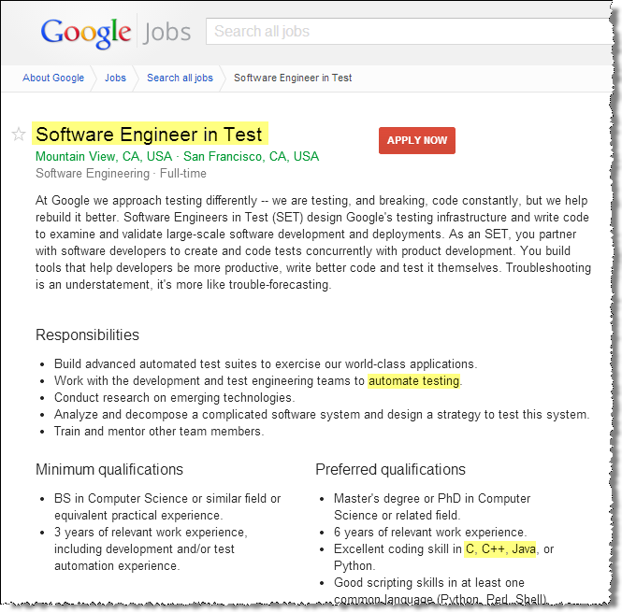

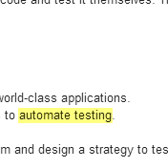
Testing as a career…?
Easier to get in, get ahead
Blame others, not get blamed
So, don’t rule out testing as a career path!
Still can code
Notes:
If you think testing isn't for you because you'd rather code - that’s not necessarily a valid argument.
Why? Because modern testing is heavily focused on coding, especially at companies like Google, where testers are called 'Software Engineers in Test.’
Their main job is to automate testing, which involves writing a lot of code.
And the language doesn’t even matter as long as you’re proficient in it.
So, don’t dismiss testing as a career option. If you focus on this path, you could land a great position, even at a top company, without necessarily being at the top of your class.

Slide 53
Testing as a career…?
Test-savvy coders are good coders
Notes:
Finally, even if you ultimately want to become a software engineer, keep in mind that if you don't value testing or want to do it, it's unlikely you'll become a good software engineer. Proper testing is essential for ensuring code quality, and without it, you won’t be able to build reliable software.

Slide 54
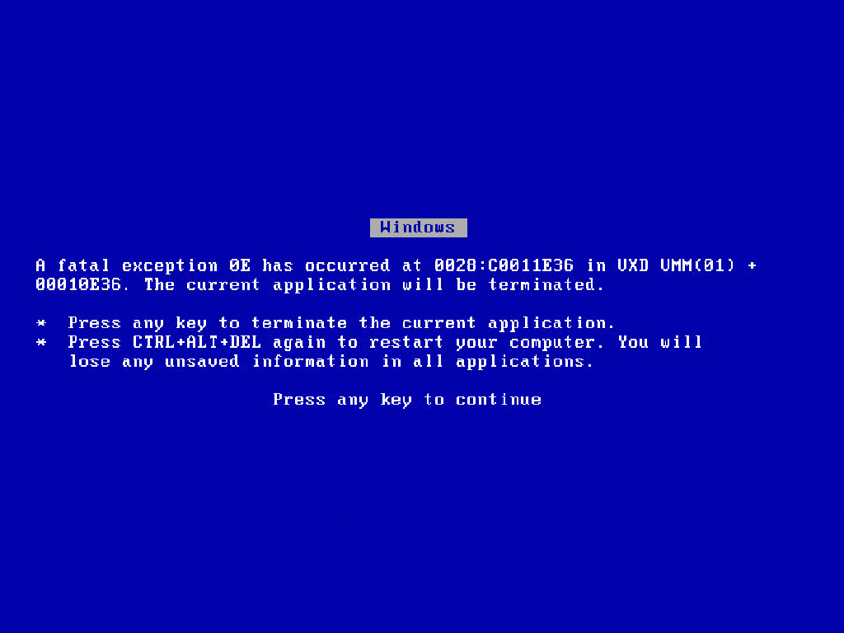
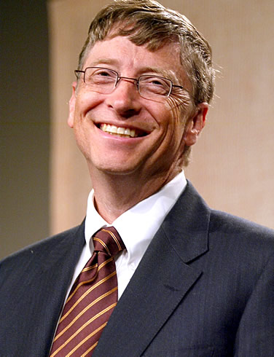
[extra] BSoD
No need to celebrate! This is a simulation ☺
Notes:
OMG!, my power point scrashed?
Just kidding : )
These days, you don't see this as much because there’s a newer, prettier version. Does anyone know what this is called? The Blue Screen of Death. This one here is just a simulation, though.
But the question is: after all these years, why hasn’t Microsoft managed to eliminate these critical bugs that crash an entire operating system? They have the talent, the resources, and they’ve certainly had the time—over 20 years. Yet, these bugs still exist. Why?
In theory, they could have fixed every bug. But it's actually a good thing they didn't. Why? Because if they had, we might have had to wait 10 years for the next version of Windows, and it would probably cost $100,000. They would need to recover the enormous costs of testing every single aspect.
The point is, testing is expensive. It's not simply a matter of 'more testing is better.' There’s a limit because of the costs involved. That’s why we need to learn how to maximize the effectiveness of our testing efforts.

Slide 55
Notes:
And for that, we'll be learning this in the coming week.

Slide 56
Add all target features in v1.4 !
Notes:
Alright, switching back to the team project.
You should aim to implement at least a rough version of all features you plan to include in the final version. The subsequent iterations focus on testing, polishing, documenting etc. So, the features should go into the product in this iteration itself.
You'll be starting this next major iteration, which is going to be the biggest one. The reason is that after this iteration, you won’t be able to add or change any features unless it's strictly a bug fix. We have a very strict definition of what qualifies as a bug because there will be a feature freeze two weeks from now.
After that point, no changes will be allowed except for bug fixes. So, over the coming weeks, put in your best effort and implement everything that’s necessary—not necessarily as much as possible, but enough to meet the requirements.

Slide 57
